Slide 1


The Impact of Technology in a Changing World
1
Adapted from
Technology in Action (2019)
by Alan Evans, Kendall Martin and Mary Anne Poatsy
Pearson Education
15th Edition

Slide 2

Learning Objectives – At end of the class you should be able to
Describe various technological tools being used to impact national and global issues.
Describe various global social issues that are being affected by technology.
Describe how technology is changing how and why we connect and collaborate with others.
Summarize how technology has impacted the way we choose and consume products and services.
Characterize computer literacy and explain why it is important to be computer literate.
Describe artificial intelligence systems and explain their main goals.
Describe how artificial intelligence and other information technologies are providing career opportunities.
Define ethics and describe various ethical systems.
Describe influences on the development of your personal ethics.
Present examples of how technology creates ethical challenges.

Slide 3
Fubini’s law
1. People initially use technology to do what they do now – but faster.
2. Then they gradually begin to use technology to do new things.
3. The new things change life-styles and work-styles.
4. The new life-styles and work-styles change society …
… and eventually change technology.

Slide 4

Technology in a Global Society – impact on national and global issues
Accelerating change around the world
Galvanizing (shocking) people in new ways
Examples
Social networking tools enable groups to connect and exchange ideas
Crisis-mapping tools collect and map information

Slide 5

Technology in a Global Society
Health Care
Develop and accelerate research and solutions such as vaccines
Smart Implants that can report accurate functional issues
Recognize early patterns of degeneration
Embedded sensors to improve performance
Used to design and construct prosthetic devices
Digestible microchips transmit information to the doctor
The Environment
Conserve energy and reverse environmental damage
Streaming media and digital cloud based storage reduce storage devices
Smart devices managing efficient energy use

Slide 6
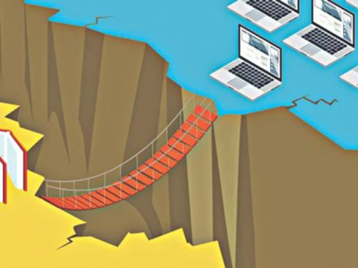
Technology in a Global Society
Technology driven digital divide into three stages:
Economic Divide:
The idea that some people can afford to have a computer and Internet access while others cannot.
Tim Berners-Lee put forward case for Universal Rights for Internet access following impact of technology during the current covid-19 crisis
Usability Divide:
“technology remains so complicated that many people couldn’t use a computer even if they got one for free.”
Even for those who can use a computer, accessing all the benefits of having one is beyond their understanding.
Empowerment divide:
It is the most difficult to solve. It is concerned with how we use technology to empower ourselves.
Very few users truly understand the power that digital technologies can give them.

Slide 7
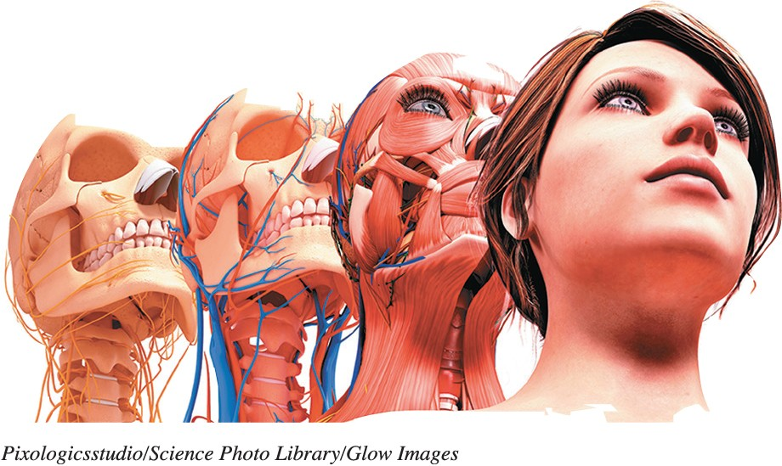
Working with Artificial Intelligence and Other Information Technologies
Law Enforcement
Solve crimes
Search databases
Computer forensics
Psychology
MACH—My Automated Conversation CoacH
Affective computing: Devices that can recognize, interpret, process, and simulate human emotions/feelings– Emotional Intelligence, Facial affect Detection and skin response

Slide 8
Ethical Computing
Set of moral standards that govern the use of computers
Concerns with areas on
Privacy
Data Storage and sharing
Unauthorised use including hacking
Governed through
Laws and Regulations such as General Data Protection Regulation (GDPR), Data Protection, and Intellectual Property Rights

Slide 9
General Data Protection Regulation
The General Data Protection Regulation 2016/679 is a regulation in EU law on data protection and privacy in the European Union and the European Economic Area
The GDPR sets out seven key principles:
Lawfulness, fairness and transparency
Purpose limitation
Data minimisation
Accuracy
Storage limitation
Integrity and confidentiality (security)
Accountability

Slide 10
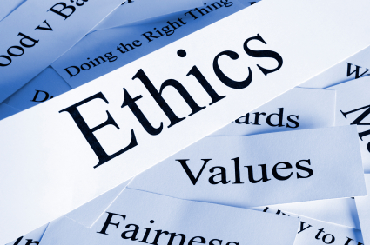
Ethical Computing and Personal Ethics
Determining Your Personal Ethics
Describe yourself
List key principles
Identify external influences
Consider why?
Prepare statement of values

Slide 11
Ethical Computing
Intellectual Property
Work that is the result of someone’s creativity and knowledge
Protected by copyrights, patents, and trademarks
Privacy
Control and privacy of information will continue to be a fine balancing act

Slide 12
Ethical Computing
Social Justice
Predictive policing to prevent crime
Military secrets and previously secret documents (WikiLeaks, Panama Papers)
Liability
3D printing can lead to quality control issues
Censorship
Global differences in website blocking

Slide 13
Ethical Computing (contd)
Social Activism
Hacktivism is using computers and computer networks in a subversive way
Often manifests as Denial of Service (DOS) attacks
Automated Systems and Robotics
Self Checkouts
Self-driving cars
Choose between sets of bad choices

Slide 14
Myths, Fears, and Fact of Technology
Technology Takes away Jobs
Technology creates new opportunities
Technology Creates psychological problems
Technology is making us stupid and lazy
Technology Creates Divide and Bias
Technology (Artificial Intelligence) will take over our lives
Smart use of technology provides solutions to problems
Technology make us take smarter decisions and improve work
Technology don’t, humans do
Technology can be solution to many problems facing humans such as climate, medicine, and business

Slide 15
The End

